Slide 1
US Census Data Acquisition and Use
A comparison of Different Methods
Robert Pickering

Slide 2
City SDK
Strengths
Built in Query Builder
Many Examples
List of aliases to assist in building queries
Growing Eco-System
Potential to access other modules in addition to Census Module
Weaknesses
Not all measures sought by County Stat are available
Language is JavaScript instead of R
Where the web page containing the Javascript would reside is not clear
Output is in JSON format which must be parsed
Notes:
There are many things that can be said in favor of using the City SDK. It has what appears to be a quickly growing ecosystem targeted towards citizen hacktivists. There are many example applications already build as well as a query builder to assist in development. In fact, the aliases provided for the Census API ACS tables were very helpful in deciphering the somewhat arcane Census Table names. The great thing about the City SDK toolkit is that it was created for the specific purpose of developing apps for citizen engagement. If County Stat were building a website from scratch, this would be a great option to seriously consider since is has the ability to leverage not only Census data, but a growing group of other datasets.
As it stands however, the need to develop a script to aggregate Census data and format it into a CSV is not easily met with the use of this particular tool. The SDK is written in JavaScript which, is not easily adapted to an R scripting environment (one of the goals of the project). In order to meet the needs of the project, there would need to be several intermediate steps taken before the final CSV could be produced. The complexity of developing a script based on this SDK calls into question the long term sustainability of any solution upon which it is based.
Perhaps the most fatal aspect of using the City SDK is that it does not provide access to every measure sought by County Stat. This means that any solution developed using this SDK would only be partial and not provide the complete functionality expected.

Slide 3
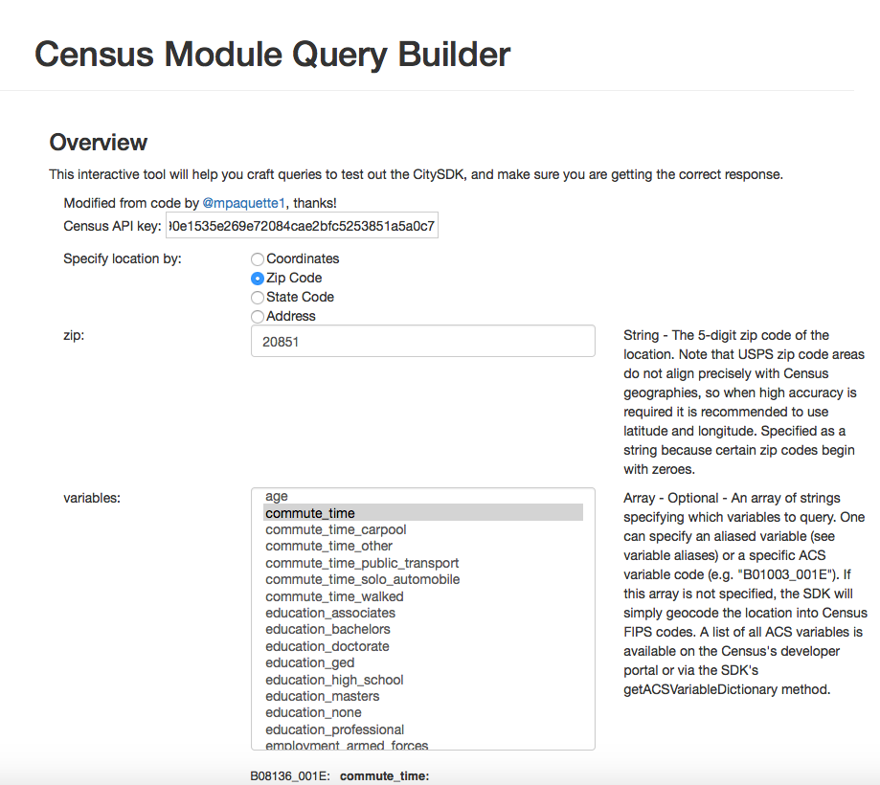
City SDK Query Builder

Slide 4
Census API
Strengths
Limited reliance on 3rd party packages
Method for developing script has no constraints based on other packages
Scripting can be written completely in R
Weaknesses
API calls must all be created by hand
May be difficult to implement command line arguments.
Output is JSON and must be parsed
Table codes and Geographic codes must be known in advance
Queries are not human readable
Documentation on the government website is unclear
Notes:
There are many ways to access the Census API to obtain ACS data as it is available via a REST API. It is possible to formulate the correct data string and enter it into a browser address bar and obtain JSON formated data in the browser window. Of course for the purposes of this project, that is not the desired output format. It is possible to build these REST queries in R and pass them to the Census API using the RCurl package which, is a wrapper for libcurl (a command line to for accessing web pages). The results are JSON formatted and can be passed to a variable which can then be converted to a dataframe. The data frame can then be manipulated to taste and ultimately be written to a CSV file. While there is some reliance on packages such as RCurl and JSONlite, these packages are so heavily used by the R community that it is likely that the will be consistently maintained into the future.
The main drawback to directly obtaining ACS data via API calls is that all of the queries must be hand coded. Additionally, the names of States and Counties cannot be used in the creation of the queries but must instead be the numeric codes. The same goes for table names. Tables must be explicitly written out in there alphanumeric format. All of this information must either be known in advance or it must be painstakingly search for on the Census website. The documentation on the Census' website is also not very clear when it comes to the correct format of the query. As all of the queries are written out, the ability to break the code up into modules is limited. Also, there will be a steep learning curve for anyone who attempts to maintain the script(s) in the future.

Slide 5
Census API Example
("jsonlite", repos="http://cran.r-project.org")
library(jsonlite)
install.packages("RCurl", repos="http://cran.r-project.org")
library(RCurl)
key <- "f1390e1535e269e72084cae2bfc5253851a5a0c7"
acsmeasures <- c("B25003_001E",
"B25101_006E",
"B25106_028E",
"B25077_001E",
"B25111_001E",
"B08136_001E",
"B08136_007E",
"B17001_002E",
"B19013_001E",
"B23025_002E",
"B15003_023E")
urlbase <- ("http://api.census.gov/data")
acsyears <-2005:2014
oneyear <- c(1,1,1,1,1,1,1,1,1,1)
threeyear <- c(0,0,1,1,1,1,1,1,1,0)
fiveyear <- c(0,0,0,0,1,1,1,1,1,0)
acsdata <- data.frame(oneyear,
threeyear,
fiveyear,
row.names = acsyears)
urlquery <- paste0(urlbase,"/",acsyears[7],
"/acs5?get=NAME,"
,acsmeasures[1],
"&for=state:22&key="
,key, collapse =" ")
output <- getURLContent(urlquery)
formatted <- fromJSON(output)
> formatted
[,1] [,2] [,3]
[1,] "NAME" "B25003_001E" "state"
[2,] "Louisiana" "1675097" "22"

Slide 6
ACS-R
Strengths
Simplified method for creating geographies
This allows geo sets to be fed into queries allowing for a more modular approach to data collection
Produces data objects that contain:
Estimate
Standard Error
Confidence Interval
Uses the same API call as the Census API
Scripting can be totally in R
Has a mailing list to ask questions
Extensive Documentation with examples
Weaknesses
Completely dependent on a third party package
Code developed against current version could break as changes are made
Code of the ACS-R package is not clean or well documented
Notes:
ACS-R is a package written specifically to abstract the process of creating queries of the Census' API. There are several methods available that assist in developing geographies as well as being able to find tables by searching on partial names. Geographies can be built as concatenated arrays and then passed to the package to retrieve the relevant tables. The data elements returned contain the: Estimate, Standard Error, and Confidence Interval for the table requested. There are extensive examples available in the documentation as well as articles written describing different use cases.
The results of the queries are returned as data objects which can be accessed via methods that will bring the data into data frames. Each of the data frames may be combined to create one data frame and written to a CSV file. Perhaps the greatest strength is the modularity afforded by using this package. Instead of one big script that produces results, several smaller scripts could be written and called from each other. For instance, there could be one script that builds geographies, another that finds tables, and another that combines the two to develop the query. Finally, there could be one that simply formats the retrieved data and writes the CSV file.
The real weakness of using the ACS-R package is that is a niche 3rd party package that is not very well documented internally (not very well commented). There are whole sections of the code that are commented out but left in which are carry overs from previous versions. If there are changes in the Census API, there is no guarantee that the package will be updated in a timely manner. Also, the package could be changed and not support backward compatibility.

Slide 7
ACS-R Example
#Make a list of Geo Locations
California = geo.make(state = "CA", county = c("Contra Costa", "Marin", "San Mateo", "Ventura", "Santa Clara"))
Colorado = geo.make(state = "CO", county = "Douglas")
DC = geo.make(state = "DC")
Illinois = geo.make(state = "IL", county = c("DuPage", "Lake"))
Indiana = geo.make(state = "IN", county = "Hamilton")
Kansas = geo.make(state = "KS", county = "Johnson")
Maryland = geo.make(state = "MD", county = c("Anne Arundel", "Baltimore County", "Frederick", "Howard", "Montgomery", "Prince George's County"))
#Combine all together to make one geo.set
allStateCounties = California + Colorado + DC + Illinois + Indiana + Kansas + Maryland
#2011 TENURE – Universe: Occupied housing units
tenure2011 =acs.fetch(endyear = "2011", span = "5",
geography = allStateCounties,
table.number = "B25003")
> tenure2011
ACS DATA:
2007 -- 2011 ;
Estimates w/90% confidence intervals;
for different intervals, see confint()
B25003_001 B25003_002 B25003_003
Contra Costa County, California 370925 +/- 1248 253163 +/- 2245 117762 +/- 1939
Marin County, California 102832 +/- 942 64786 +/- 980 38046 +/- 1080
San Mateo County, California 256423 +/- 1000 1 54127 +/- 1519 102296 +/- 1353
Ventura County, California 264982 +/- 1014 174310 +/- 1632 90672 +/- 1556
Santa Clara County, California 599652 +/- 1905 351897 +/- 3114 247755 +/- 2642
Douglas County, Colorado 100795 +/- 553 82110 +/- 791 18685 +/- 698
District of Columbia 260136 +/- 1572 111381 +/- 1525 148755 +/- 1895
DuPage County, Illinois 335651 +/- 1181 254592 +/- 1921 81059 +/- 1555
Lake County, Illinois 239947 +/- 1276 186237 +/- 1301 53710 +/- 1210
Hamilton County, Indiana 98959 +/- 720 78993 +/- 972 19966 +/- 932
Johnson County, Kansas 212587 +/- 900 152175 +/- 1182 60412 +/- 1137
Anne Arundel County, Maryland 197348 +/- 984 147837 +/- 1618 49511 +/- 1430
Baltimore County, Maryland 315127 +/- 1393 210981 +/- 1888 104146 +/- 1597
Frederick County, Maryland 85048 +/- 602 64588 +/- 930 20460 +/- 895
Howard County, Maryland 103547 +/- 636 76862 +/- 991 26685 +/- 873
Montgomery County, Maryland 355434 +/- 1383 244497 +/- 1668 110937 +/- 1391
Prince George's County, Maryland 302091 +/- 1438 193551 +/- 1808 108540 +/- 1726

Slide 8
Recommendation
For the purposes of this project, it seems that the solution with the greatest capability would be one built on the ACS- R package.
While there are potentially serious sustainability issues associated with choosing this solution, it is anticipated that in the near term, it will deliver the capability required by County Stat.

